Slide 1
Malnutrition - causes and types
By: Neha Guliani

Slide 2
Malnutrition - causes and types
Malnutrition especially that affecting young children is one of the principle public health problems in the developing world like India. It causes about half of child deaths and is a major cause of morbidity in children. It has medical and social disorder rooted in poverty and discrimination. It has economic ripple effect that hampers development
Effects of malnutrition in early childhood can be devastating and permanent. Whether or not children are well-nourished during the prenatal period and the first years of life can have a profound effect on their health status, as well as their ability to learn, communicate, socialize, reasoning and adapt to their environment

Slide 3
Ecology of under nutrition
Malnutrition is an ecological problem that does not occur alone. It accompanies poverty, disturbed family structure, ignorance and despair.
Poverty
Because of low purchasing power, poor cannot afford to buy desired amount and desired quality of food for the family. This adversely affects their capacity for physical work and they earn less. Thus starts a vicious cycle of poverty, under nutrition, diminished work capacity, low earning and poverty
Feeding habits
Lack of awareness of nutritional qualities of food, irrational beliefs about food, inappropriate child rearing and feeding habits all lead to under nutrition in the family.

Slide 4
Ecology of under nutrition
Infections
Infections like malaria and measles or recurrent attacks of diarrhoea may precipitate acute malnutrition and aggravate the existing nutritional deficit. Metabolic demands for protein are higher during infections and the child may take in less food either due to reduced appetite or due to food restrictions by the mother. Thus leading to malnutrition

Slide 5
Socio-cultural factors
Inequitable distribution of food in the family. In most of the poor households, women and preschool children especially girls receive less food than the economically active male members
Large families Rapid succession of pregnancies adversely affects the nutritional status of the mother. As she tries to manage the big family she may neglect her own health and antenatal checkups during pregnancy. Under nutrition may lead to low birth weight baby. In large families per capita availability of food is also less.
Poor quality of housing, sanitation and water supply. These contribute to ill health and infections thus Contributing to malnutrition.

Slide 6
Socio-cultural factors
Inadequate maternal and child care- Improving the primary health centres and other health care services in the rural areas will definitely improve the nutrition profile of women and children.

Slide 7
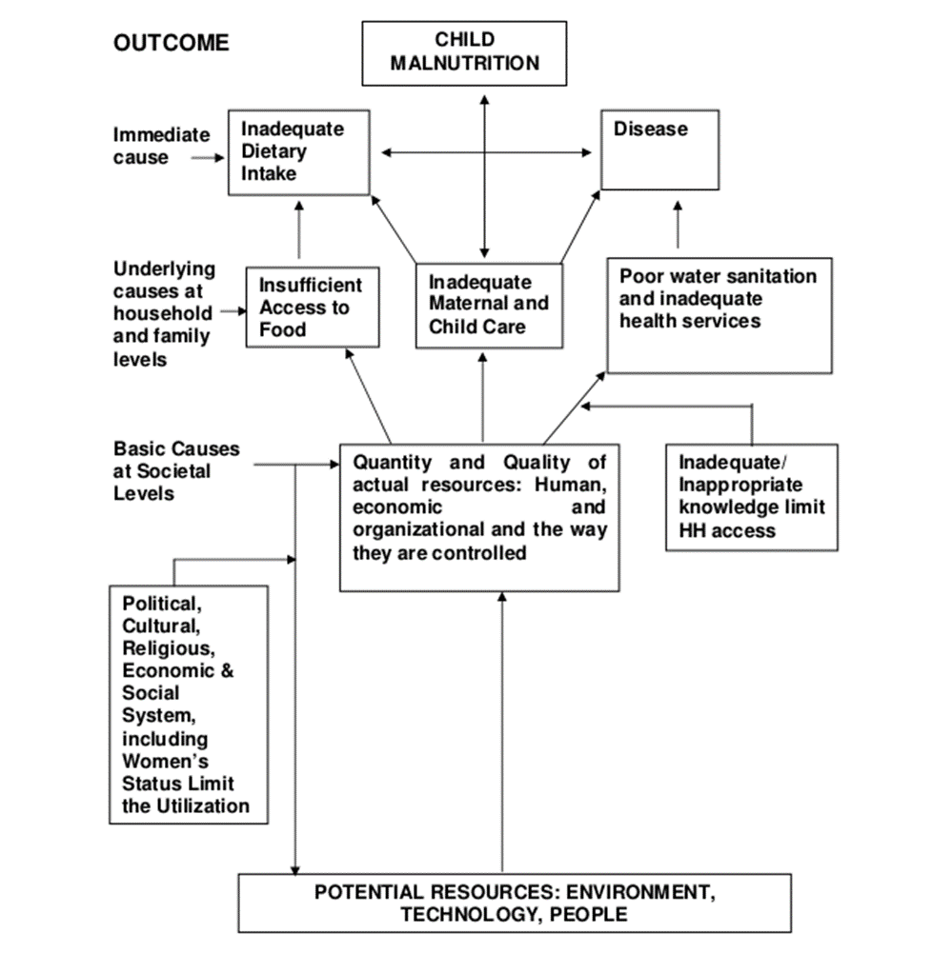
Causes of child malnutrition can be summarised as below.

Slide 8
Groups of population most affected
Certain groups of population may be most affected because of their,
Biological vulnerability as in infants, preschool children, pregnant mothers, adolescent girls and old people.
Socioeconomic factors like poor, socially deprived, slum dwellers, street kids, etc.
Habitat such as those living in inaccessible remote areas, thick forests and mountainous regions e.g., tribal population and nomads.

Slide 9
Groups of population most affected
the elderly - particularly those who are in hospital, or institutionalized,
people with low incomes, or those who are socially isolated,
people with chronic (long-term) disorders - for example, eating disorders, such as anorexia nervosa and bulimia, and
people who are recovering from a serious illness, or condition - particularly those with a condition that affects their ability to eat, such as a stroke.

Slide 10
Symptoms
Signs and symptoms of undernutrition include:
lack of appetite or interest in food or drink
tiredness and irritability
inability to concentrate
always feeling cold
loss of fat, muscle mass, and body tissue
higher risk of getting sick and taking longer to heal
longer healing time for wounds
higher risk of complications after surgery
depression
reduced sex drive and problems with fertility
In more severe cases:
breathing becomes difficult
skin may become thin, dry, inelastic, pale, and cold
the cheeks appear hollow and the eyes sunken, as fat disappears from the face
hair becomes dry and sparse, falling out easily

Slide 11
Symptoms
Eventually, there may be respiratory failure and heart failure, and the person may become unresponsive. Total starvation can be fatal within 8 to 12 weeks
Children may show a lack of growth, and they may be tired and irritable. Behavioral and intellectual development may be slow, possibly resulting in learning difficulties.
Even with treatment, there can be long-term effects on mental function, and digestive problems may persist. In some cases, these may be lifelong.
Adults with severe undernourishment that started during adulthood usually make a full recovery with treatment.

Slide 12
Causes
Malnutrition can result from various environmental and medical conditions.
1) Low intake of food
This may be caused by symptoms of an illness, for example, dysphagia, when it is difficult to swallow. Badly fitting dentures may contribute.
2) Mental health problems
Conditions such as depression, dementia, schizophrenia, anorexia nervosa, and bulimia can lead to malnutrition.
3) Social and mobility problems
Some people cannot leave the house to buy food or find it physically difficult to prepare meals. Those who live alone and are isolated are more at risk. Some people do not have enough money to spend on food, and others have limited cooking skills.

Slide 13
Causes
4) Digestive disorders and stomach conditions
If the body does not absorb nutrients efficiently, even a healthful diet may not prevent malnutrition. People with Crohn's disease or ulcerative colitis may need to have part of the small intestine removed to enable them to absorb nutrients.
Celiac disease is a genetic disorder that involves a gluten intolerance. It may result in damage to the lining of the intestines and poor food absorption.
Persistent diarrhea, vomiting, or both can lead to a loss of vital nutrients.
5) Alcoholism
Addiction to alcohol can lead to gastritis or damage to the pancreas. These can make it hard to digest food, absorb certain vitamins, and produce hormones that regulate metabolism.
Alcohol contains calories, so the person may not feel hungry. They may not eat enough proper food to supply the body with essential nutrients.

Slide 14
6) Lack of breastfeeding
Not breastfeeding, especially in the developing world, can lead to malnutrition in infants and children.

Slide 15
Risk factors
In some parts of the world, widespread and long-term malnutrition can result from a lack of food.
In the wealthier nations, those most at risk of malnutrition are:
older people, especially those who are hospitalized or in long-term institutional care
individuals who are socially isolated
people on low incomes
those who have difficulty absorping nutrients
people with chronic eating disorders, such as bulimia or anorexia nervosa
people who are recovering from a serious illness or condition

Slide 16
Diagnosis
Prompt diagnosis and treatment can prevent the development and complications of malnutrition.
There are several ways to identify adults who are malnourished or at risk of malnutrition, for example, the Malnutrition Universal Screening Tool (MUST) tool.
MUST has been designed to identify adults, and especially older people, with malnourishment or a high risk of malnutrition.
It is a 5-step plan that can help health care providers diagnose and treat these conditions.

Slide 17
Here are the steps:
Step 1: Measure height and weight, calculate body mass index (BMI), and provide a score.
Step 2: Note the percentage of unplanned weight loss and provide a score. For example, an unplanned loss of 5 to 10 percent of weight would give a score of 1, but a 10-percent loss would score 2.
Step 3: Identify any mental or physical health condition and score. For example, if a person has been acutely ill and taken no food for over 5 days, the score will be 3.
Step 4: Add scores from steps 1, 2 and 3 to obtain an overall risk score.
Step 5: Use local guidelines to develop a care plan.

Slide 18
If the person is at low risk of malnutrition, their overall score will be 0. A score of 1 denotes a medium risk and 2 or more indicates a high risk.
MUST is only used to identify malnutrition or the risk of malnutrition in adults. It will not identify specific nutritional imbalances or deficiences.

Slide 19
Treatment
Following the MUST screening, the following may happen:
Low risk: Recommendations include ongoing screening at the hospital and at home.
Medium risk: The person may undergo observation, their dietary intake will be documented for 3 days, and they will receive ongoing screening.
High risk: The person will need treatment from a nutritionist and possibly other specialists, and they will undergo ongoing care.
For all risk categories, help and advice on food choices and dietary habits should be offered.

Slide 20
Treatment types
The type of treatment will depend on the severity of the malnutrition, and the presence of any underlying conditions or complications.
The healthcare provider will prepare a targeted care plan, with specific aims for treatment. There will normally be a feeding program with a specially planned diet, and possibly some additional nutritional supplements.
People with severe malnourishment or absorption problems may need artificial nutritional support, either through a tube or intravenously.
The patient will be closely monitored for progress, and their treatment will be regularly reviewed to ensure their nutritional needs are being met.

Slide 21
Diet
A dietitian will discuss healthful food choices and dietary patterns with the patient, to encourage them to consume a healthy, nutritious diet with the right number of calories. Those who are undernourished may need additional calories to start with.

Slide 22
Monitoring progress
Regular monitoring can help ensure an appropriate intake of calories and nutrients. This may be adjusted as the patient's requirements change. Patients receiving artificial nutritional support will start eating normally as soon as they can.

Slide 23
Prevention
To prevent malnutrition, people need to consume a range of nutrients from a variety of food types. There should be a balanced intake of carbohydrates, fats, protein, vitamins, and minerals, as well as plenty of fluids, and especially water.
The best way to prevent malnutrition is to eat a healthy, balanced diet.
A healthy, balanced diet is vital for maintaining health and fitness. To stay healthy, you need to eat a variety of foods from the four main food groups including:
plenty of fruit and vegetables
plenty of bread, rice, potatoes, pasta and other starchy foods
some milk and dairy foods
some meat, fish, eggs, beans and other non dairy sources of protein

Slide 24
The United Nations Decade of Action on Nutrition
On 1 April 2016, the United Nations (UN) General Assembly proclaimed 2016–2025 the United Nations Decade of Action on Nutrition. The Decade is an unprecedented opportunity for addressing all forms of malnutrition. It sets a concrete timeline for implementation of the commitments made at the Second International Conference on Nutrition (ICN2) to meet a set of global nutrition targets and diet-related NCD targets by 2025, as well as relevant targets in the Agenda for Sustainable Development by 2030—in particular, Sustainable Development Goal (SDG) 2 (end hunger, achieve food security and improved nutrition and promote sustainable agriculture) and SDG 3 (ensure healthy lives and promote wellbeing for all at all ages).

Slide 25
Led by WHO and the Food and Agriculture Organization of the United Nations (FAO), the UN Decade of Action on Nutrition calls for policy action across 6 key areas:
creating sustainable, resilient food systems for healthy diets;
providing social protection and nutrition-related education for all;
aligning health systems to nutrition needs, and providing universal coverage of essential nutrition interventions;
ensuring that trade and investment policies improve nutrition;
building safe and supportive environments for nutrition at all ages; and
strengthening and promoting nutrition governance and accountability, everywhere.

Slide 26
How to tackle India's undernutrition crisis in 10 steps
The finance ministry and the planning department can play an overarching role by ensuring health programmes get sufficient resources
India is the epicenter of a global stunting crisis. At least 39% of the country's children under five - about 47 million souls - suffered from stunting in 2015. That's more stunted children, proportion-wise, than in all of Africa, where the figure is 32%.
One way to address the crisis is through nutritional schemes for pregnant women and children. While such programmes exist, state support to them hasn't been adequate of late, as laid out in a report titled Under Nutrition In India - A Nutrition Budget Disconnect.
Indeed, this year's budget made no significant increase in the allocation for nutrition-related schemes. The Centre, in fact, passed the burden on to the states, asking them to set their own nutrition priorities and pay up to half the funds needed for programmes like the ICDS.
Here's what the report - released on 11 March by the Centre for Budget and Governance Accountability and UNICEF and partly written by prominent food rights experts - prescribes for tackling the crisis.

Slide 27
1) Ensure better coordination among various ministries
To tackle malnutrition, it's imperative that the following ministries work together:
Rural Development
Public Distribution and Civil Supplies
Health and Family Welfare
Women and Child Development
Drinking Water and Sanitation
Agriculture
Tribal Affairs
Minority Affairs
By coordinating their efforts, these ministries will ensure that essential nutrition services reach the most deprived communities.
The finance ministry and the planning departments, the report points out, can play an overarching role by ensuring such programmes get sufficient budgets, resources and a policy framework.

Slide 28
2) Improve data collection on stunting and obesity
Although the practice of measuring malnutrition, through the ICDS, on the "underweight criterion" - weight for age - is expedient at the village level, it doesn't count stunted and wasted children with the same frequency, Aarti Ahuja, a food rights expert, argues in the report.Another area of neglect is the measurement of obesity. According to the WHO, India's obesity rate rose from 4% to 4.9% between 2010 and 2014, sending India off-course in meeting the WHO's obesity reduction targets.
The report notes that appropriate policies can only be designed if proper and timely information and data is collected not just on underweight children but the overweight ones as well.

